Slide 1
Board Recruitment
Information Pack

Slide 2
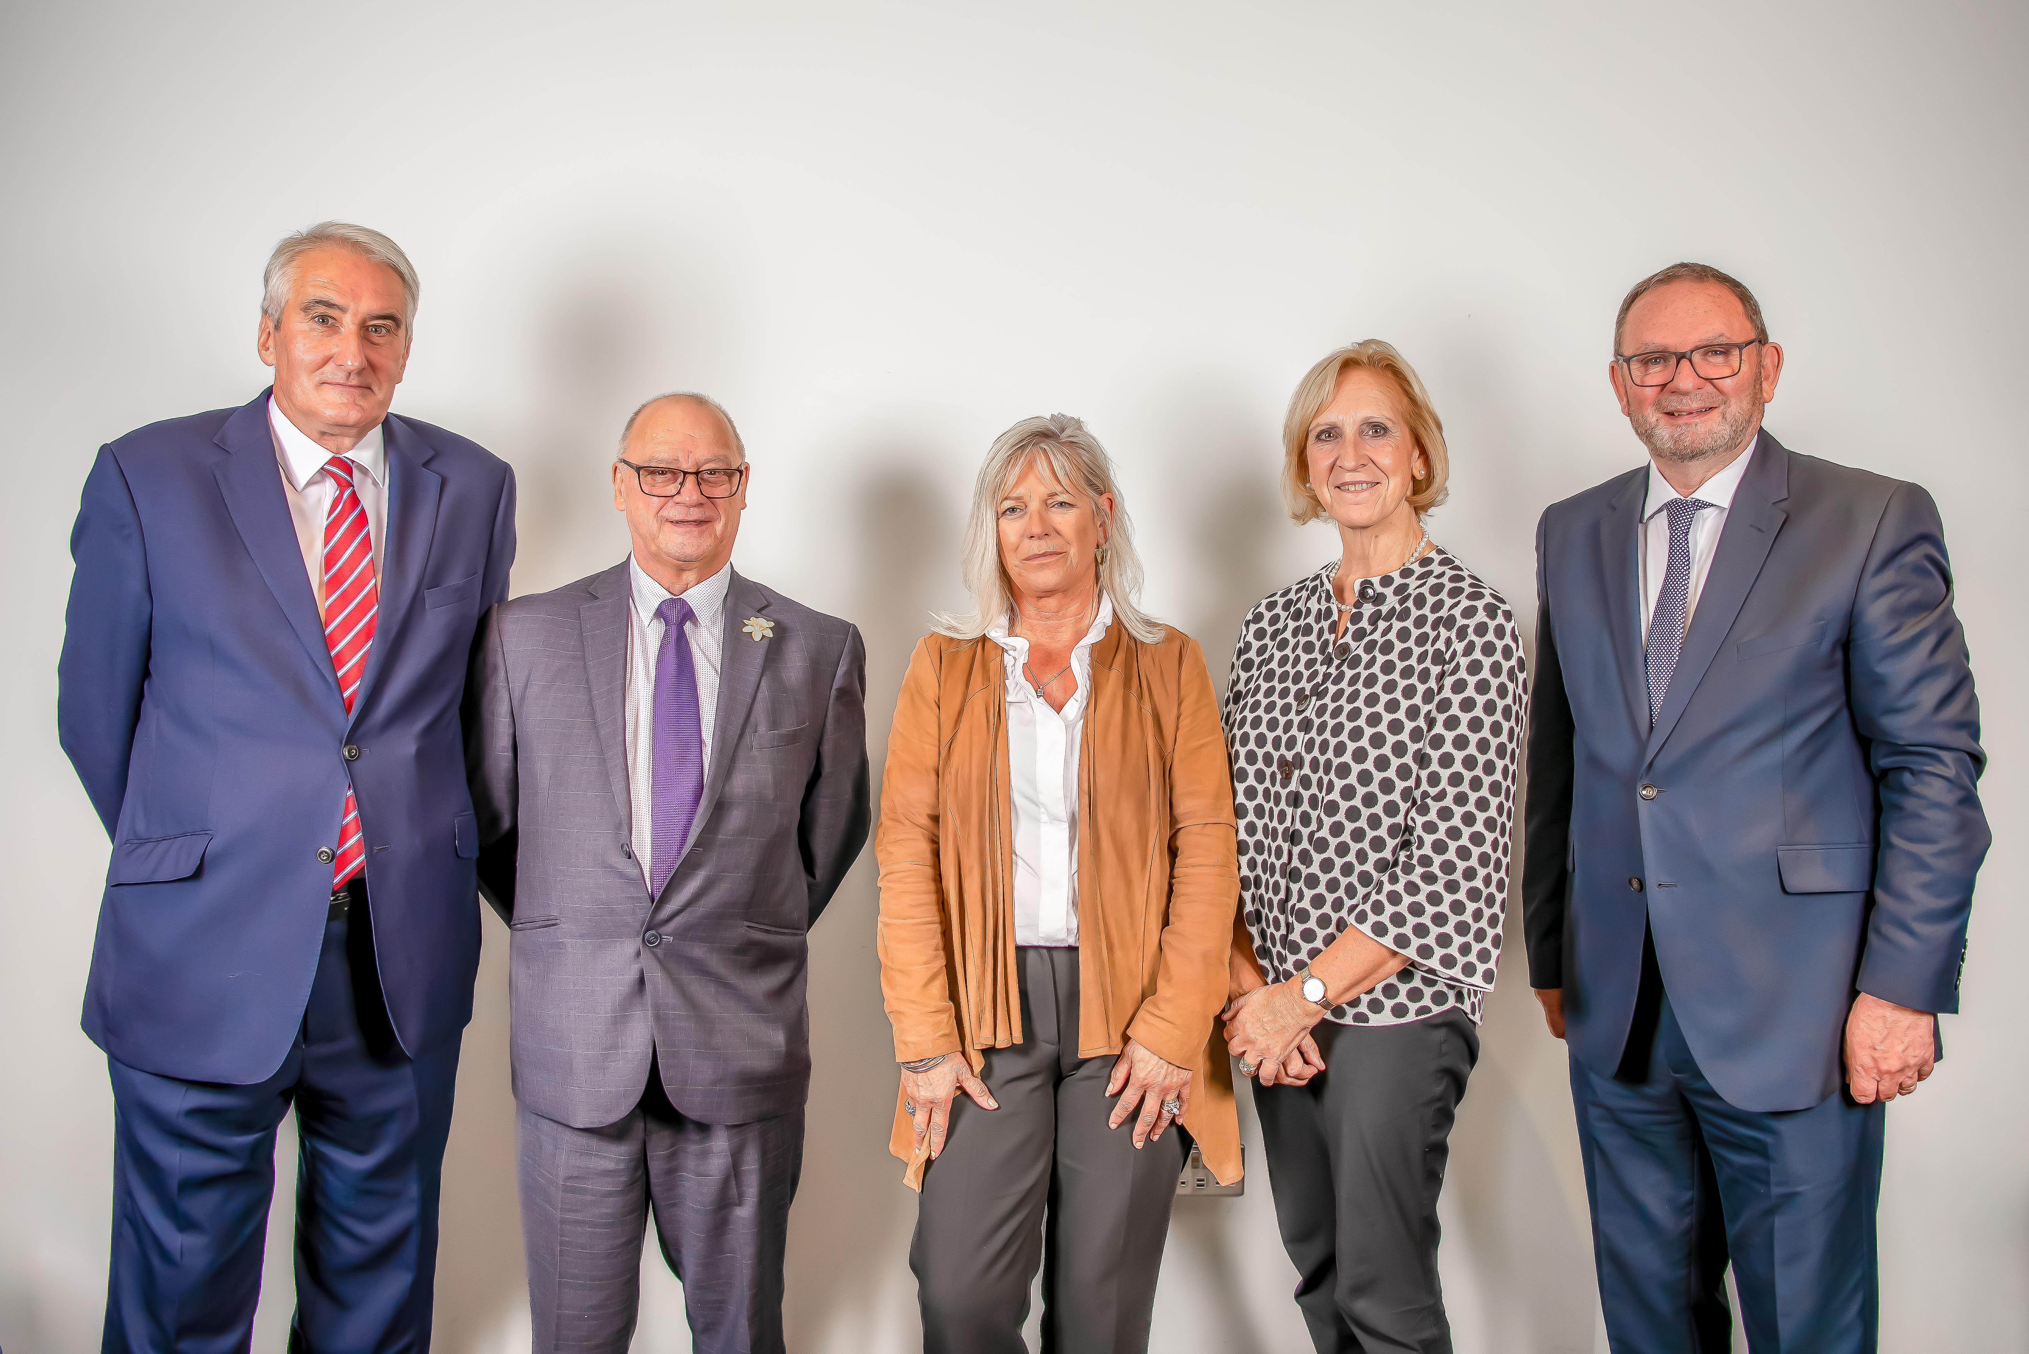
Contents
About Us p.3
Our Purpose, Vision & Values p.4
Join our Board! p.5
Contact details p.7

Slide 3
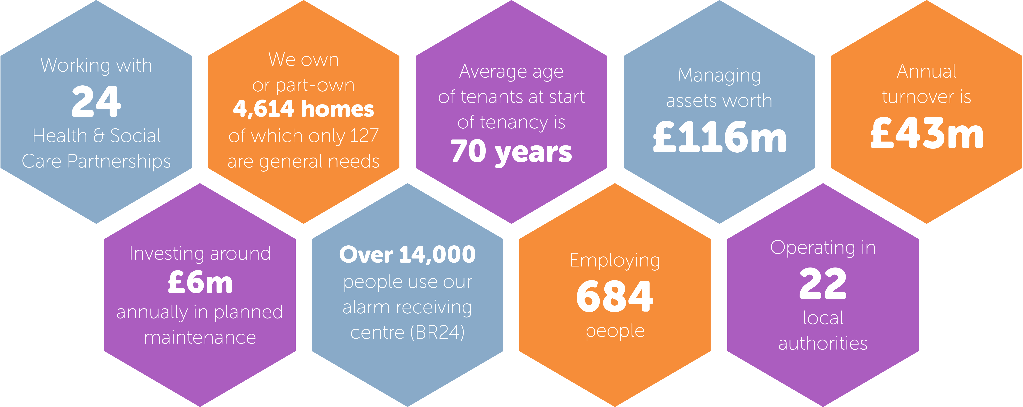
About Us

Slide 4
Purpose | Vision | Values
We make it possible for more people to live their best lives, at home, surrounded by a supportive community. | We will lead, set and deliver the global standard for ageing at home. | Ambition Caring Dignity Equality & Diversity Honesty Inclusion Kindness

Slide 5
Join our team!
For over 50 years, we have been doing our best to deliver quality housing and support for older people. We have been very lucky in attracting talented and committed Board members to lead us.
Bield’s Corporate Strategy & Business Plan for 2023-28 keeps our focus firmly on our customers and features a comprehensive set of objectives and outcomes.
We’re looking for new Board members to help us to meet the challenges ahead.
In particular, we’re looking for strategic thinkers with experience in:
Housing
Health & Safety
Non-Executive Director roles
Lesley Holdsworth, Chair of the Board

Slide 6
You could be the one we’re looking for!
We want people who share our purpose, vision and values.
In return, you’ll gain a real sense of making a difference and be inspired by meeting some of the most enthusiastic and committed employees. You will also have access to learning and development opportunities.
You won’t be paid but you’ll be reimbursed for out of pocket expenses.
Interested? We’d love to hear from you. We want to attract applicants from all backgrounds, communities and ages to reflect Scotland’s rich diversity.

Slide 7
Contact details
Deadline for applications: Friday 11th August 2023
Date of interview: Friday 18th August
For more information about Bield and/or to arrange a discussion with the Chair, please contact Sharon Mackintosh, via email at: s.mackintosh@bield.co.uk
For an application pack, please email: c2@bield.co.uk or visit: www.bield.co.uk

